Slide 1
Propensity of customer who buying

Slide 2
Process Flow
Full Sample
Estimate Propensity Score (Pro of buying)
~multivariable logistic regression (Predicts log odd of buying)
Propensity Score Matching
Matched Sample

Slide 3
Data Cleaning:
After doing Business and Data Understanding
We are doing descriptive and exploratory analysis
We will do Model Building
There are various kinds of matching using the Propensity score ,we are using Nearest neighbour matching with 1:1 ratio
The Other kinds of matching are Calliper matching & Nearest neighbour matching with variable ratio 1:4,subclassification by propensity score, full matching
To run the propensity score I use matchit function

Slide 4
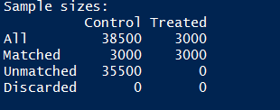
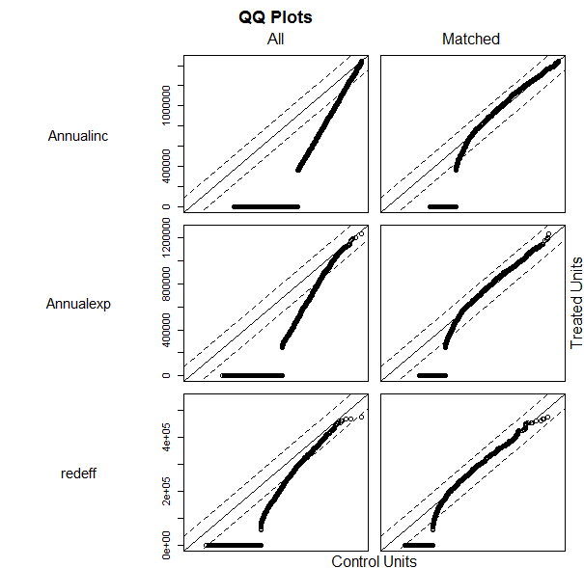
Matching Treatment Analysis
We are going to use the Distance, treatment variable & covariant. We will check the values before and after treatment

Slide 5
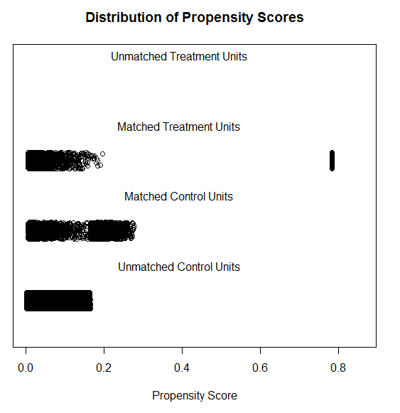
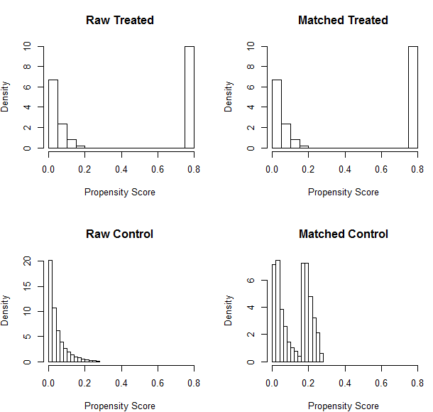
Using Jitter Plot
To find the distribution's & propensity score location using Jitter plot
We can see change in distribution before and after matching using histogram

Slide 6
Saving the matched data
We are saving final matched data using Write.CSV Function
When you open the file the values are inserted into the file .We can use load that file into STATA,SAS,SPSS for further analysis

